Slide 1
1. What role did the Church play in helping Clovis conquer other Germanic peoples?
2. What role did Pope Gregory the Great play in spreading the idea of a vast unified kingdom?
3. What was important about Charles Martel’s victory at the Battle of Tours?
4. How did Pepin the Short strengthen the Frankish kingdom?
5. What was the importance of Charlemagne’s coronation as emperor?
6. How did Charlemagne govern his unified kingdom?

Slide 2
Geography
Europe is bordered by water.
Highly populated.
1/3 of the land is good for farming. (that’s a lot!)
Forests provided plenty of wood (natural resources)
Notes:
7.6.1

Slide 3
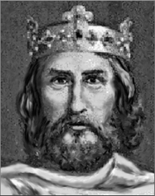
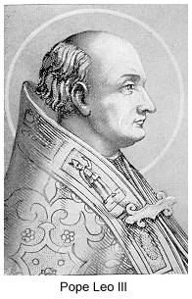
Charlemagne vs Pope Leo
Notes:
7.6.4

Slide 4
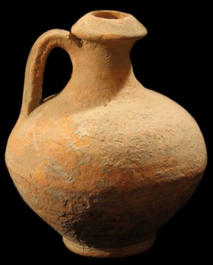
Analyze this
Look carefully at the following painting showing Charlemagne being crowned by the pope. Write who in the picture appears to be more powerful/important. Include evidence from the painting to support your claim.
Notes:
Give odd object/building from culture – analyze it.

Slide 5
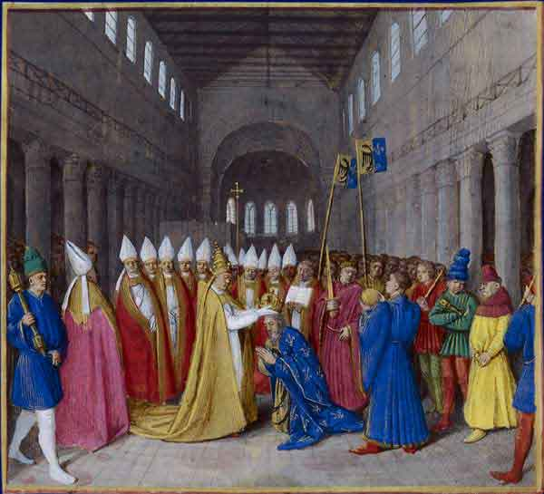
Pope Leo
Charlemagne
Notes:
7.6.4

Slide 6
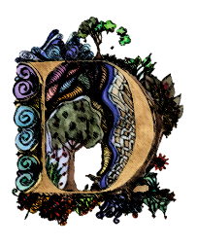
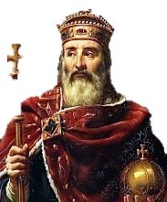
Both wanted to lead. By giving Charles the crown Leo made it seem he had the higher authority.
ARK AGES
ARK AGES
What makes a hero?
Notes:
Clip should be muted.

Slide 7
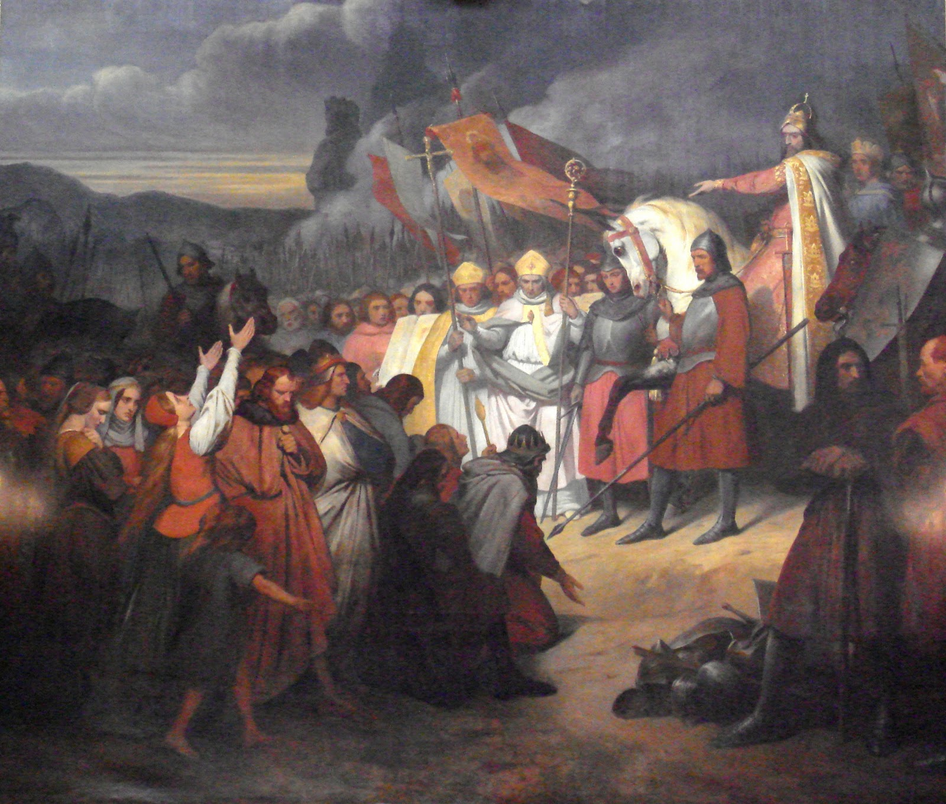
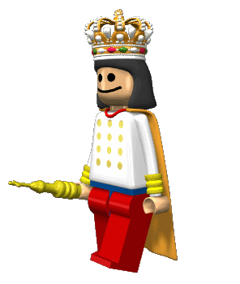
Legacy
Despite the disagreements Charlemagne became the first Emperor of Europe since the fall of Rome.
Built a massive Christian empire through war.
Built schools and encouraged education for all.
In the end he left a divided kingdom to his sons.
Not really Charlemagne
ARK AGES
ARK AGES
What makes a hero?

Slide 8
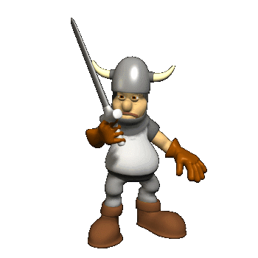
The Vikings

Slide 9
Barbarians from northern Europe.
Frozen land there meant very little food was available.
Eventually their population got so big they had to go south to find food – and they did not go peacefully!
ARK AGES
ARK AGES
What makes a hero?

Slide 10
The Vikings ruined any unity Charlemagne had built. Fear returned, trade and learning stopped once again.
ARK AGES
ARK AGES
What makes a hero?
Notes:
What was one long-term problem caused by the Viking attacks in the 800s? (7.6.2)
They killed so many monks that Christianity lost all its followers.
They carried the Black Death all over Europe.
They caused great fear and further weakened European unity.
They ruined many farms causing a great period of famine.

Slide 11
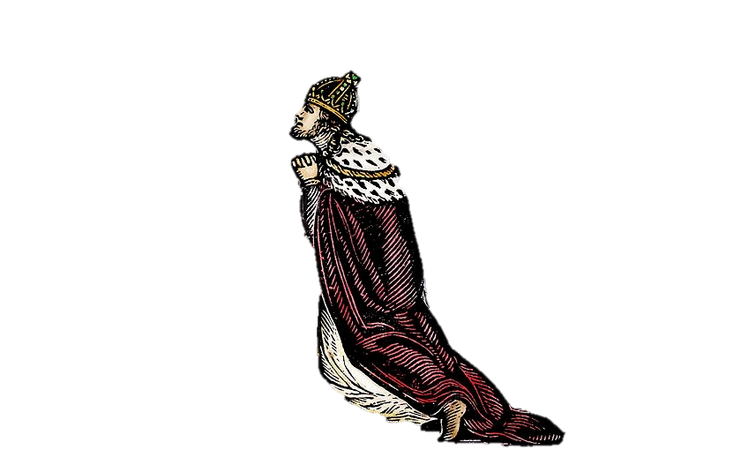
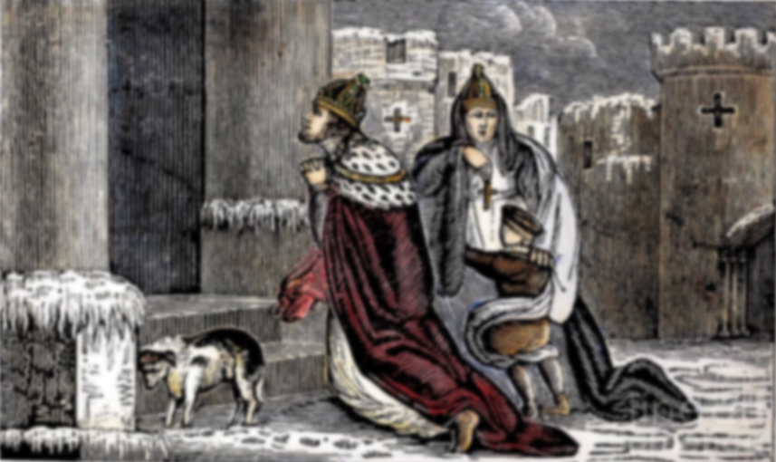
King Henry vs. Pope Gregory
ARK AGES
ARK AGES
What makes a hero?

Slide 12
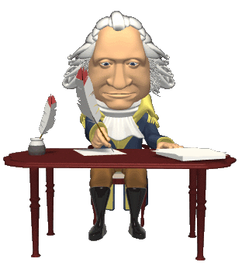
The men wanted the money that came from selling church positions. Henry felt he was right enough that he wrote a very angry letter to the Pope demanding he quit.
Henry, king not through usurpation but through the holy ordination of God, to Gregory, at present not pope but false monk. I, Henry, king by the grace of God, with all of my Bishops, say to you, come down, come down, and be damned throughout the ages. Sincerely, King Henry IV
Notes:
5. They care because of simony (selling church positions) 6. Henry sends letter demanding the pope step down and saying he’d no longer support him

Slide 13
Pope Gregory excommunicated King Henry in response removing him from the church and from his rule.

Slide 14
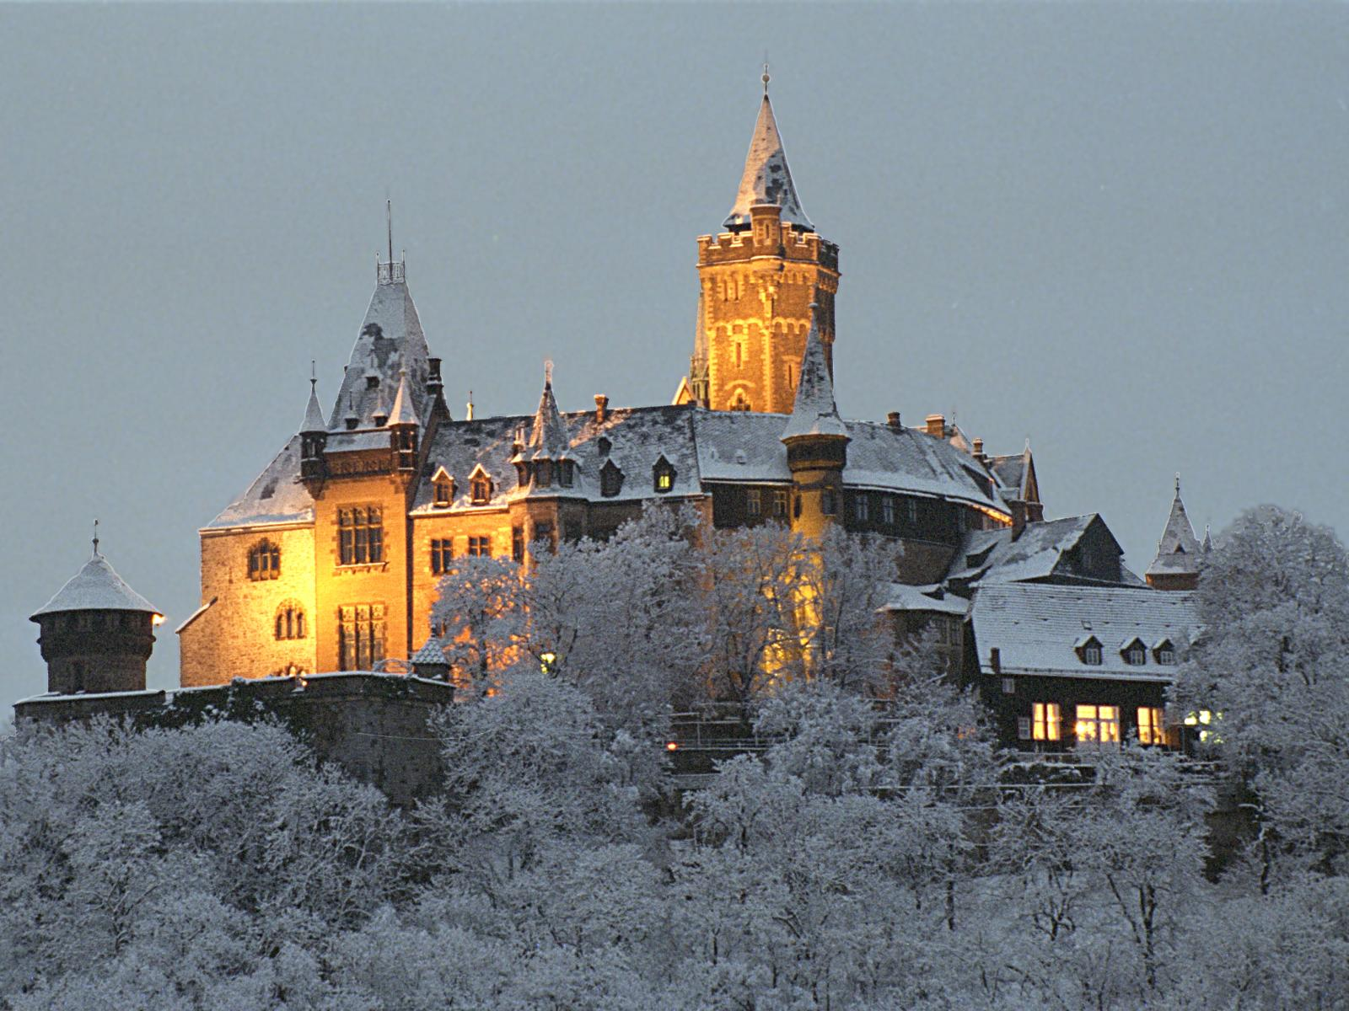
Henry went to the pope’s home and begged him for forgiveness for three days.
What? Sorry! Can’t hear you! Come back tomorrow!
I’m sorry pope, please let me in!
Notes:
8. Henry was facing rebellion in Germany so he walked to the church in Rome. 9. He stood outisde in the snow barefoot to show his penance.

Slide 15
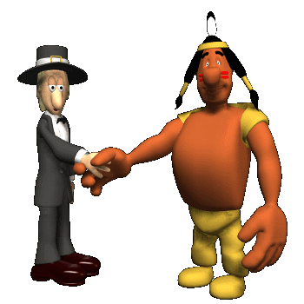
Gregory forgave him after 3 days of begging once he felt like he had proved his power over the king.
Notes:
10. He is reinstated after begging for 3 days and the pope’s power is affirmed.

Slide 16
Pope Gregory Vs Henry IV
PG questioned KH’s authority to pick bishops.
KH tried to get PG removed as Pope.
PG excommunicated KH.
KH begged for 3 days to be let back into the church so people would listen to him again.
PG let him back after proving the pope was the most powerful.

