Slide 1
Feudalism- a system of rule where people trade their work for protection
People with money bought walls and warriors to protect them.
Basic needs are provided for (but not much else)
What makes a hero?
Notes:
Which of these best defines feudalism? (7.6.2)
A political and economic arrangement in which a lord provides protection in exchange for loyalty and service.
A system of exchange where laborers work for wages in the form of money.
A hierarchy designed to ensure only monarchs are protected.
A social order with kings at the top and knights at the bottom.
Which of these was true of a feudal society? (7.6.3)
Most of people’s basic needs were cared for.
People gave loyalty directly to local lords instead of distant kings.
Serfs worked very hard but were protected.
All the above.

Slide 2
Social Structure of Feudalism
1. Explain the mutual obligations of the feudal system.
2. Explain why the feudal system often resulted in complicated alliances.
3. Describe feudal social classes.

Slide 3
Economic Structure of Feudalism
4. Explain the mutual obligations between lord and serfs under the manor system.
5. Explain why the serfs rarely had to leave their manor.
6. Explain why the serfs accepted their economic hardships.

Slide 4
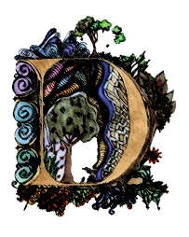
Peasants
Farmers or laborers of low social rank.
ARK AGES
ARK AGES
What makes a hero?

Slide 5
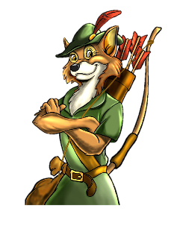
Peasant life was pretty awful.
Main food was pottage. you’d take whatever veggies you could find and boil them into a mush. Yummy!
If you didn’t boil it you might get sick from the “fertilizer” they used.
ARK AGES
What makes a hero?
Notes:
Fix it – beer!

Slide 6
They made their money from taxes and treasures taken in battle.
They treated peasants very badly because they had the direct support of the kings.
They also had enough money to “buy” salvation from the church.
Notes:
Knights are jerks

Slide 7
3-2-1
Create a 3-2-1 Summary by writing:
3-
2-
1-
Classes in Feudalism
Bad things about being a peasant
Reason knights weren’t heroes
Notes:
3-2-1 (you tube gameshow or movie countdown clip)

