Slide 1
What is a Crusade?
a war for religious reasons
Goal was to regain the “holy land” (Jerusalem) for Christians.
Pope Urban II ordered them in 1095.
He promised that any who went would go to Heaven.
Notes:
1
7.6.6

Slide 2
Jerusalem - special city for three religions-
.
For Jews - city where King David ruled and where the great Temple had stood.
For Christians- city where Jesus had lived, preached, and been crucified.
For Muslims - where their leader, Mohammed, ascended into heaven

Slide 3
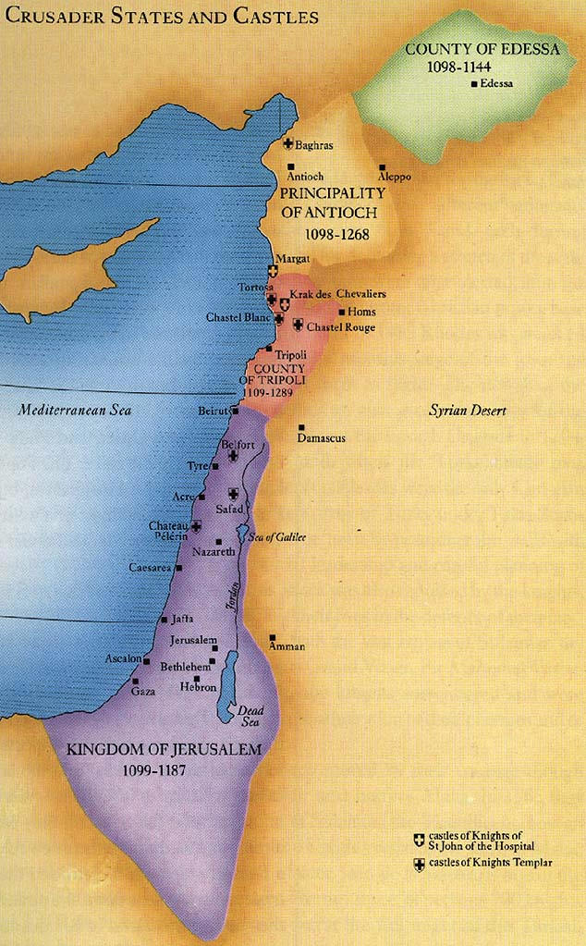
Christians set up 4 crusader states in the Holy Land

Slide 4
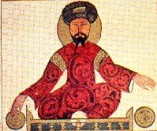
Saladin, leader of the Muslims began retaking land won in the first Crusade.

Slide 5
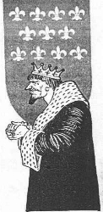
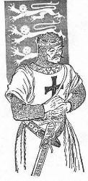
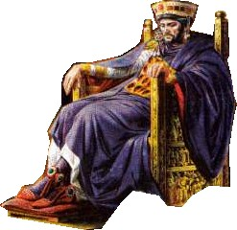
Crusade of the Three Kings
Richard the Lionhearted of England
Philip Augustus of France
Frederick Barbarossa of the Holy Roman Empire
Was called to re-take the Holy land captured by Saladin.

Slide 6
Crusade Results
Holy land remains under Arab control.
Europeans realized there was much more to the world than they ever knew
Trade and technology expanded: gun powder, coffee, etc.
Europe became more unified as the knights now had a common enemy.
Notes:
6

Slide 7
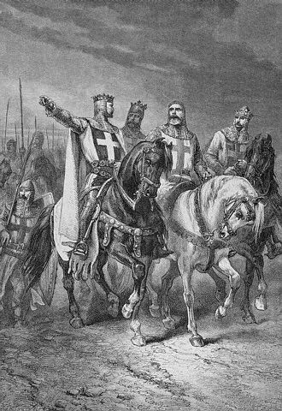
Effects of the Crusades on Europe
Increased trade with the Middle East and Byzantine Empire
Growth of money economy
Increased power of the monarchs.
Increased power of the Church
Wider world view – new inventions / ideas brought back.
Europeans want more stuff from Asia
Age of Exploration Begins

Slide 8
I, King John, accept that I have to rule according to the law.
So I agree:
1. Not to imprison nobles without trial
2. To have fair taxation for the nobles
3. To let nobles travel wherever they like
4. Not to interfere in Church matters
5. Not to take crops without paying for them
…and lot more things too!!
Notes:
7.6.5

Slide 9
And then…
After signing the document – John ignored it.
Those who signed it were hunted down and killed.
Still, this set the stage for many of our rights and freedoms found in the Constitution.
What makes a hero?
Notes:
Aftermath (maybe)

