Slide 1
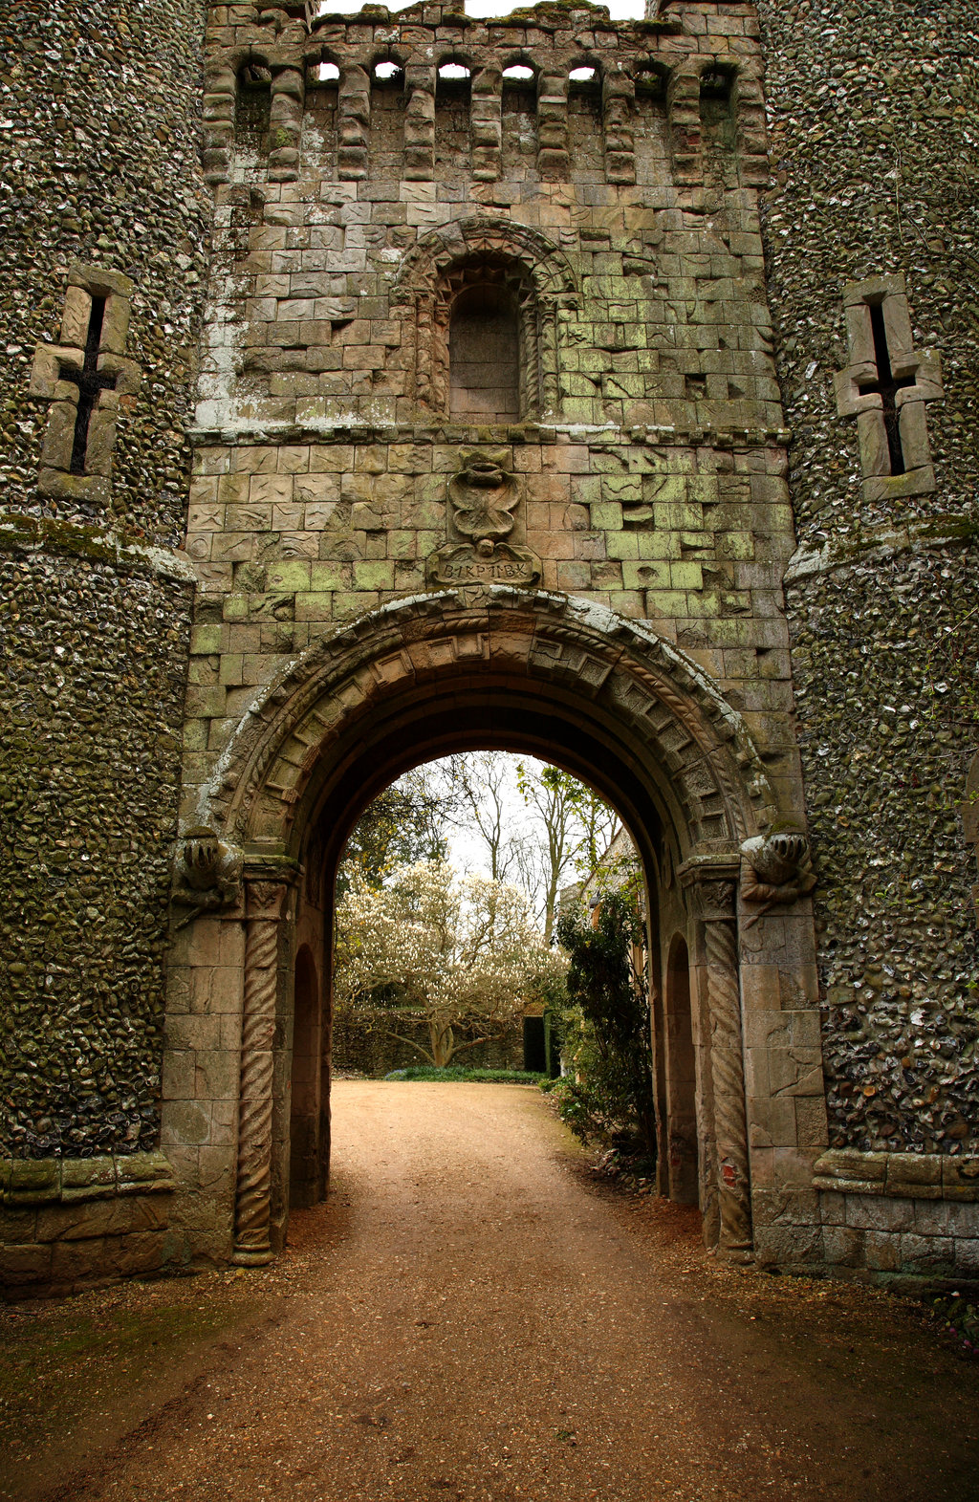
The Dark Ages
Part 1
What makes a hero?
Notes:
1 – Church
2 – Charlie
3 - Feudalism

Slide 2
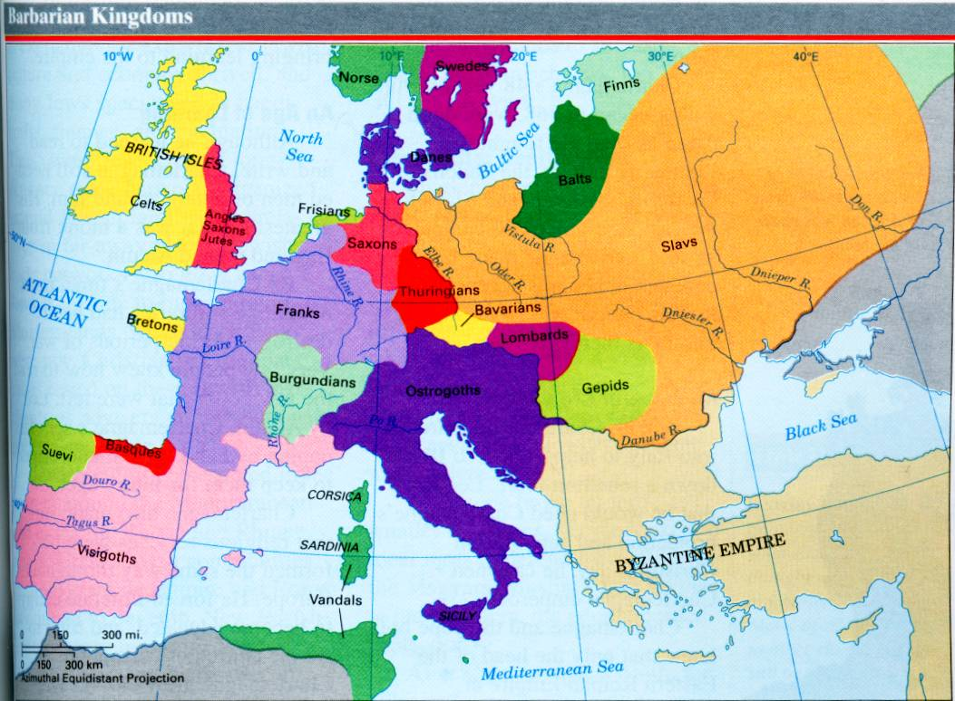
Roman Empire
The Dark Ages
Government
ARK AGES
ARK AGES
What makes a hero?
Notes:
7.6.1

Slide 3
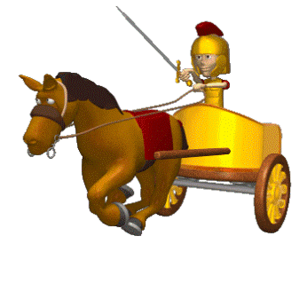
Lost Empire
When Rome fell knowledge, law, culture and technology fell with it.
The army was lost too leaving the people with no protection.
Europe broke up into a bunch of kingdoms.
Most people looked to the Church for leadership.
Notes:
Which of the following statements is true about Europe in the decades shortly after the fall of the Roman Empire? (7.6.1)
Very little changed overall except the geography.
It was broken up into many competing kingdoms.
Almost the entire population left and moved to Asia.
The church lost a great amount of power and importance.

Slide 4
Vocabulary to know:
Excommunication- removing someone’s membership to a church. (kick them out!)
Salvation- the removal of the penalties of sin.
Cathedral- a large church building
Notes:
7.6.8

Slide 5
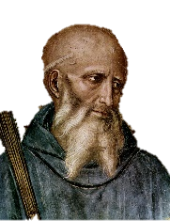
Vocabulary to know:
Excommunication - removing someone’s membership to a church. (kick them out!)
Salvation – taking away sin so people can go to Heaven.
Cathedral - a large church building
St. Benedict
Notes:
Use before storytime?

Slide 6
1. What role did the Church play in helping Clovis conquer other Germanic peoples?
2. What role did Pope Gregory the Great play in spreading the idea of a vast unified kingdom?
3. What was important about Charles Martel’s victory at the Battle of Tours?
4. How did Pepin the Short strengthen the Frankish kingdom?
5. What was the importance of Charlemagne’s coronation as emperor?
6. How did Charlemagne govern his unified kingdom?

Slide 7
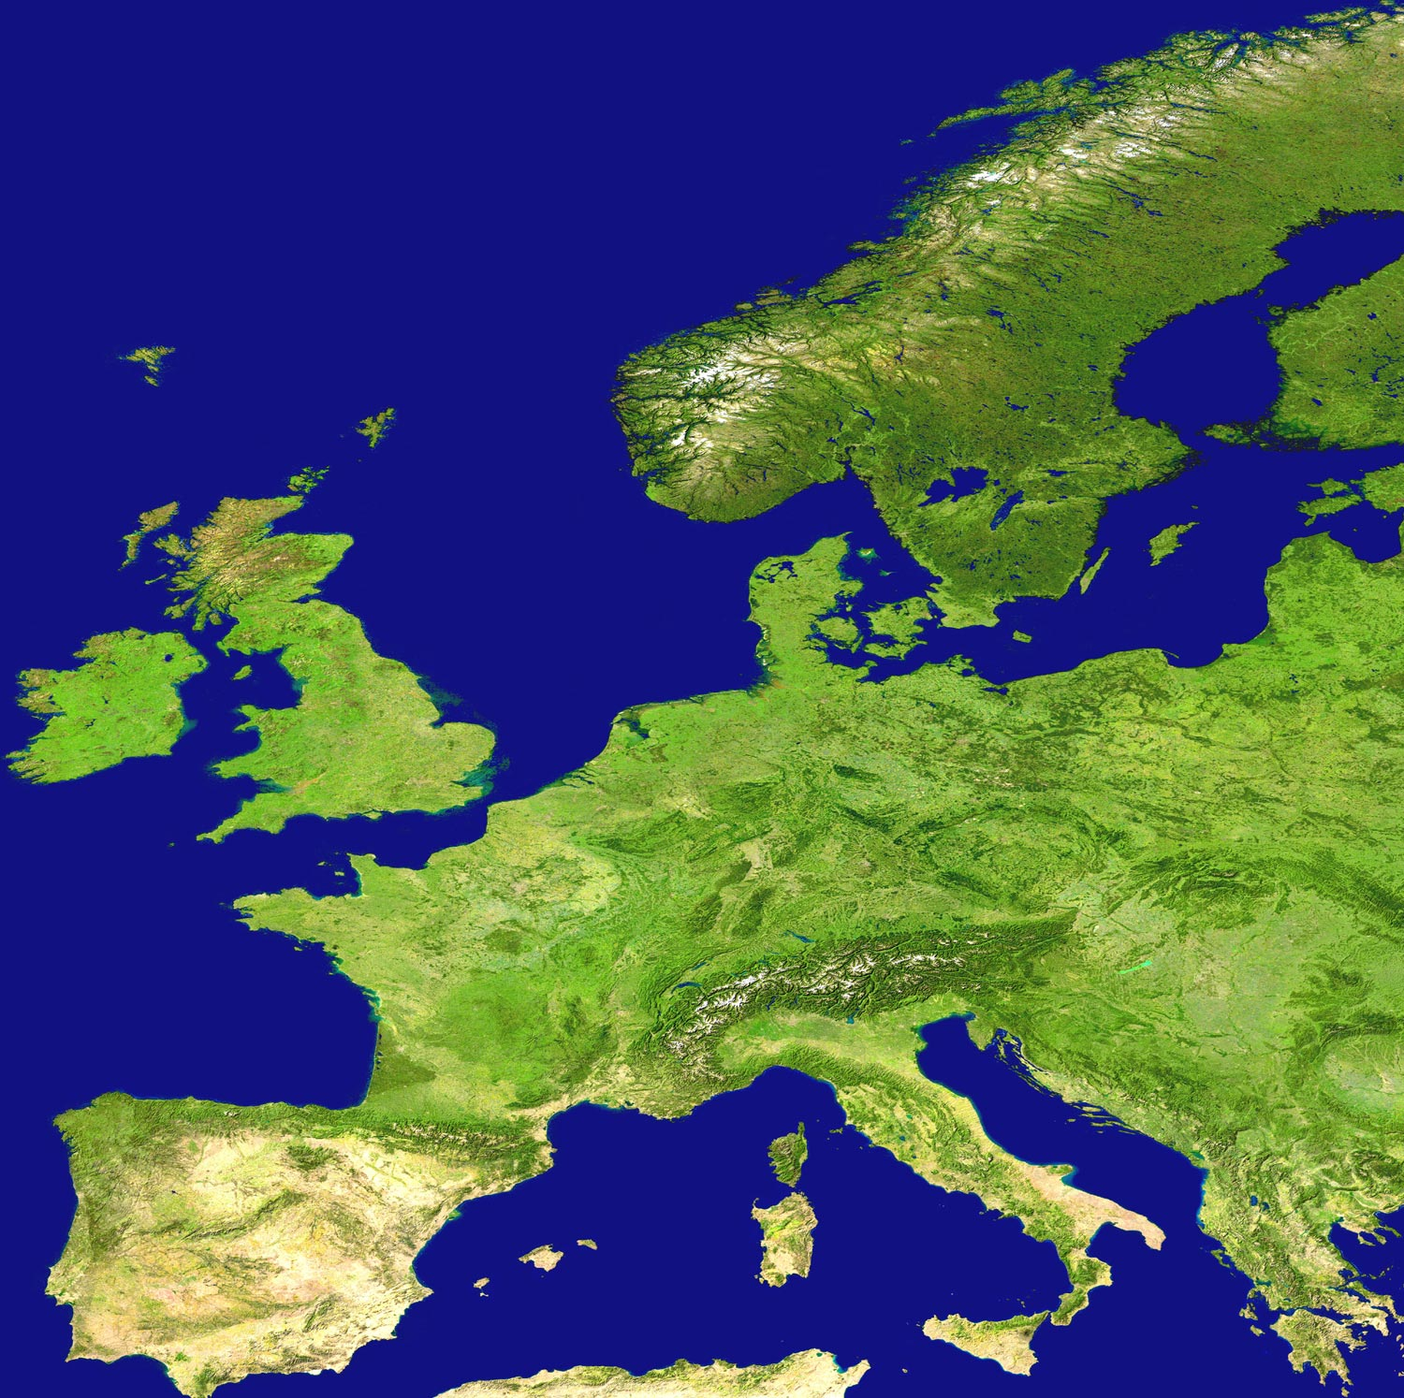
Geography
Europe is bordered by water.
Highly populated.
1/3 of the land is good for farming. (that’s a lot!)
Forests provided plenty of wood (natural resources)
Notes:
7.6.1

Slide 8
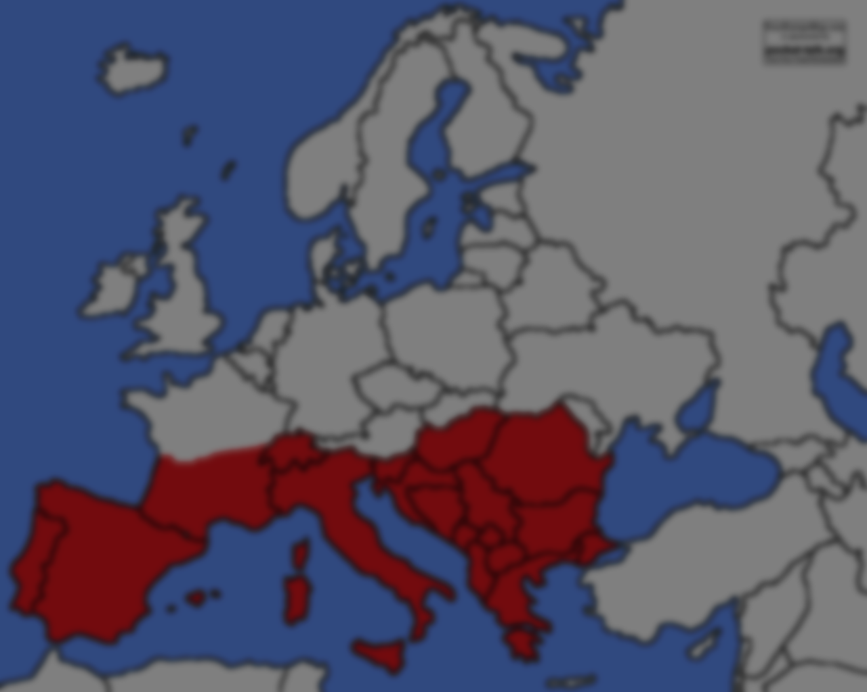
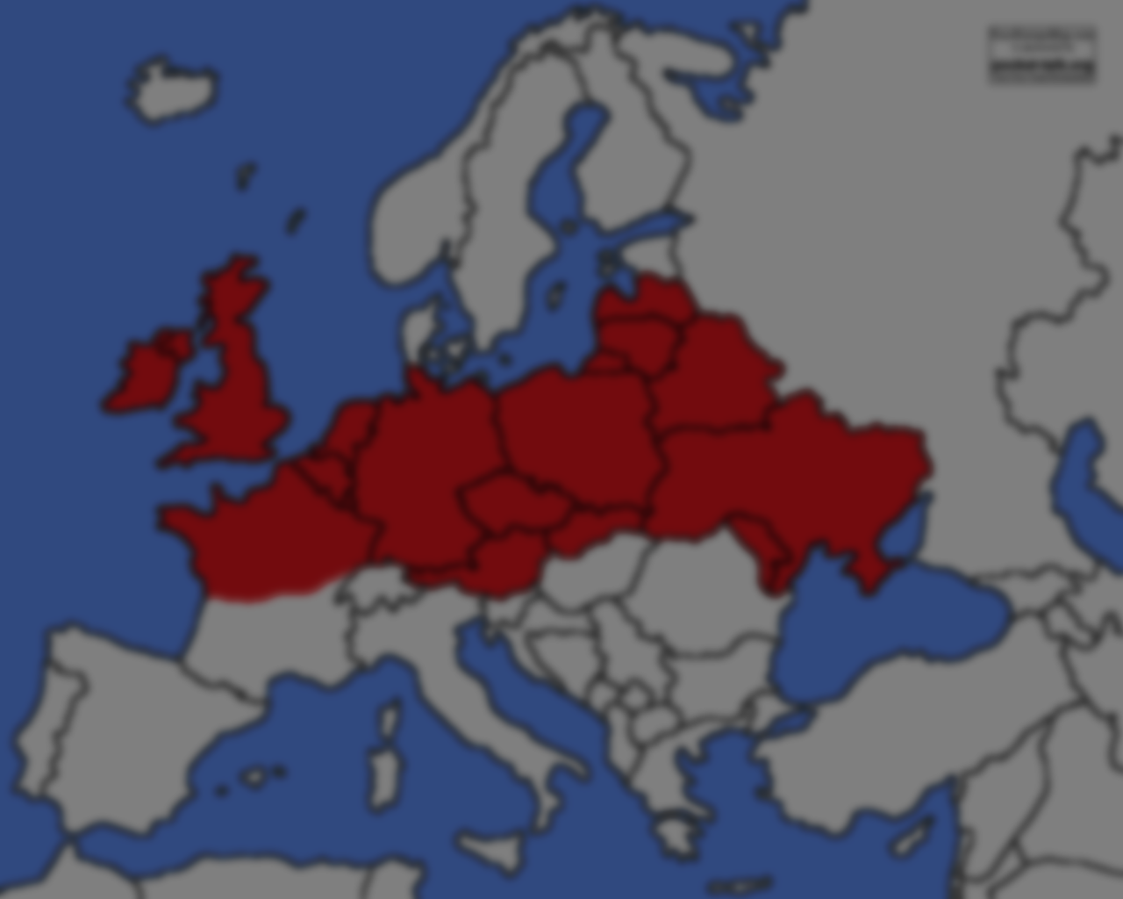
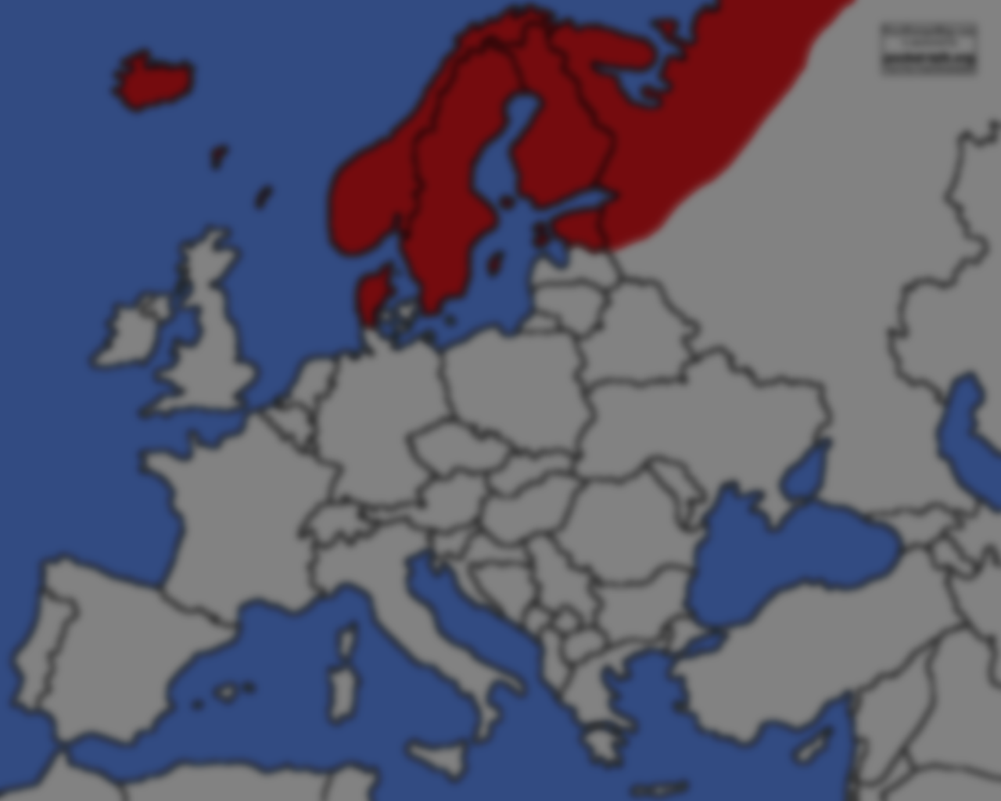
3 Zones
South- warm temp, seasonal rain – excellent farming.
North – slightly colder, heavily forested – lots of natural resources.
Scandinavia – very cold, relied on the ocean for food and resources, very different from the other two.

